Slide 1

Hypha ROS RaceCar Workshop 2017-06
Lecturer : HaoChih, LIN
林浩鋕
Day -2
Website: https://hypharosworkshop.wordpress.com/contact/
FB Page: https://www.facebook.com/HyphaROS/
Email: hypha.ros@gmail.com

Slide 2
6/10 (週六) |  |  | 6/11 (週日)
時段 | 課程 | 教室 | 時段 | 課程 | 教室
10:00 12:00 | 課程介紹 2D SLAM | 綜合教學大樓 | 09:00 12:30 | Navigation & Amcl Simulation | 綜合教學大樓
12:00 13:30 | 中午休息 (自行外出用餐) |  | 12:30 14:00 | 中午休息 (自行外出用餐)
13:30 15:30 | Laser Odom EKF (IMU+Odom) | 綜合教學大樓 | 14:00 15:30 | System Integration | 工學院交誼廳
休息10分鐘
15:40 18:30 | Base Controller & Path following | 綜合教學大樓 | 15:40 16:50 | Final Testing & Debugging | 工學院交誼廳
18:30 20:00 | 晚餐時間 (自行外出用餐) |  | 17:00 18:00 | Competition | 工學院交誼廳
20:00 21:30 | 硬體Debug (此時段非必要,依需求) | 綜合教學大樓 | 18:00 ~ | 工作坊結束
https://hypharosworkshop.wordpress.com/
Copyright © 2017 Hypha ROS Workshop. All rights reserved
Lecturer: HaoChih, LIN
Notes:
工作坊 基本介紹 （我們是誰）
兩日注意事項 （貴重物品 垃圾 午餐 晚餐 水 廁所 debug時間 隔天最終場地等）
不得錄音 錄影 可以拍照
code部份 都公開
有問題可以發問 但因為時間有限 所以太過細節部份 建議debug時段提問

Slide 3
Navigation & AMCL
move_base
costmap2d
dwa local planner
amcl
Simulation
navigation_stage
System Integration
Final Testing & Debuging
Competition
https://hypharosworkshop.wordpress.com/
Copyright © 2017 Hypha ROS Workshop. All rights reserved
Lecturer: HaoChih, LIN

Slide 4
Navigation & AMCL
https://hypharosworkshop.wordpress.com/
Copyright © 2017 Hypha ROS Workshop. All rights reserved
Lecturer: HaoChih, LIN

Slide 5
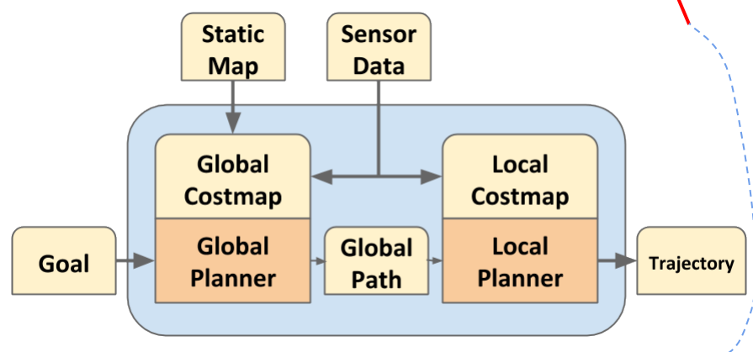
Navigation & AMCL
Overview of ROS Navigation
map server
rplidar
figure source: http://roscon.ros.org/2014/wp-content/uploads/2014/07/ROSCON2014_DLu.pdf
https://hypharosworkshop.wordpress.com/
Copyright © 2017 Hypha ROS Workshop. All rights reserved
Lecturer: HaoChih, LIN

Slide 6
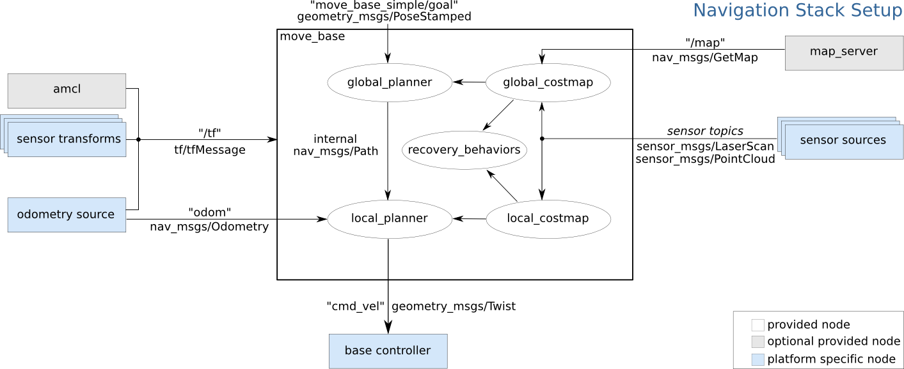
Navigation & AMCL
[move_base] concept
figure source: http://wiki.ros.org/move_base
https://hypharosworkshop.wordpress.com/
Copyright © 2017 Hypha ROS Workshop. All rights reserved
Lecturer: HaoChih, LIN

Slide 7
Navigation & AMCL
[move_base] how to send goal
Action API
move_base/goal (move_base_msgs/MoveBaseActionGoal)
move_base/feedback (move_base_msgs/MoveBaseActionFeedback)
move_base/status (actionlib_msgs/GoalStatusArray)
move_base/result (move_base_msgs/MoveBaseActionResult)
Subscribed Topics
move_base_simple/goal (geometry_msgs/PoseStamped)
[move_base] Output
Published Topics
cmd_vel (geometry_msgs/Twist)
https://hypharosworkshop.wordpress.com/
Copyright © 2017 Hypha ROS Workshop. All rights reserved
Lecturer: HaoChih, LIN

Slide 8
Navigation & AMCL
[move_base] Common parameters
~base_global_planner: global planner, navfn (Dijkstra's algorithm) [plugin]
~base_local_planner: local planner, base_local_planner or dwa_local_planner [plugin]
~recovery_behaviors: A list of recovery behavior plugins [plugin]
~recovery_behavior_enabled: recovery behaviors to attempt to clear out space
~planner_frequency: he rate in Hz at which to run the global planning loop
[move_base] Implementation (RACECAR_amcl_nav.launch)
<node pkg="move_base" type="move_base" respawn="false" name="move_base" output="screen">
<rosparam file="$(find hypha_racecar)/param/costmap_common_params.yaml" command="load" ns="global_costmap"/>
<rosparam file="$(find hypha_racecar)/param/costmap_common_params.yaml" command="load" ns="local_costmap"/>
<rosparam file="$(find hypha_racecar)/param/local_costmap_params.yaml" command="load"/>
<rosparam file="$(find hypha_racecar)/param/global_costmap_params.yaml" command="load"/>
<rosparam file="$(find hypha_racecar)/param/dwa_local_planner_params.yaml" command="load"/>
<rosparam file="$(find hypha_racecar)/param/move_base_params.yaml" command="load"/>
<param name="base_local_planner" value="dwa_local_planner/DWAPlannerROS"/>
<remap from="/odom" to="/odometry/filtered"/>
</node>
https://hypharosworkshop.wordpress.com/
Copyright © 2017 Hypha ROS Workshop. All rights reserved
Lecturer: HaoChih, LIN

Slide 9
Navigation & AMCL
[costmap2d] concept
robot
local costmap
global costmap
map
https://hypharosworkshop.wordpress.com/
Copyright © 2017 Hypha ROS Workshop. All rights reserved
Lecturer: HaoChih, LIN

Slide 10
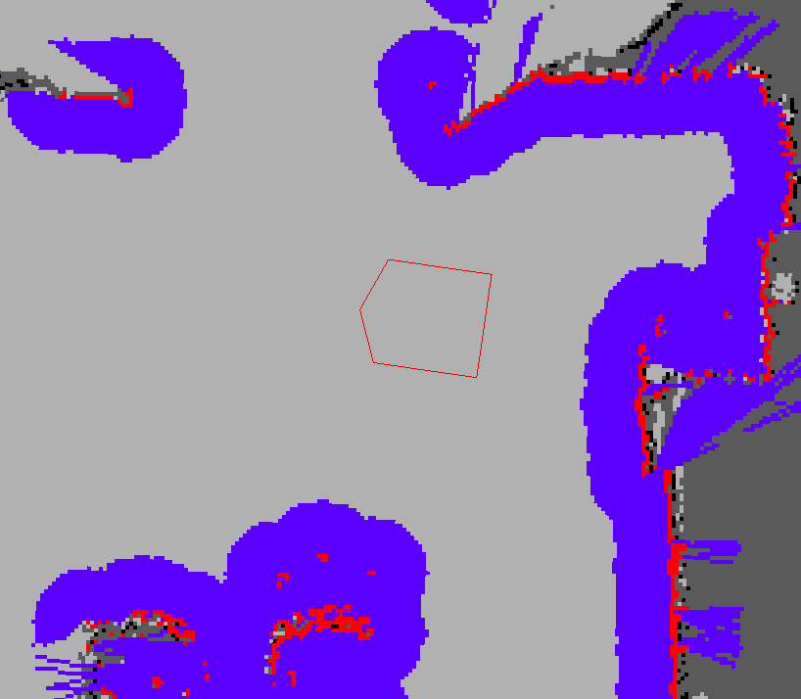
Navigation & AMCL
[costmap2d] concept
costmap_2d::LETHAL_OBSTACLE; costmap_2d::NO_INFORMATION; costmap_2d::FREE_SPACE; costmap_2d::INSCRIBED_INFLATED_OBSTACLE
figure source: http://wiki.ros.org/costmap_2d
https://hypharosworkshop.wordpress.com/
Copyright © 2017 Hypha ROS Workshop. All rights reserved
Lecturer: HaoChih, LIN

Slide 11
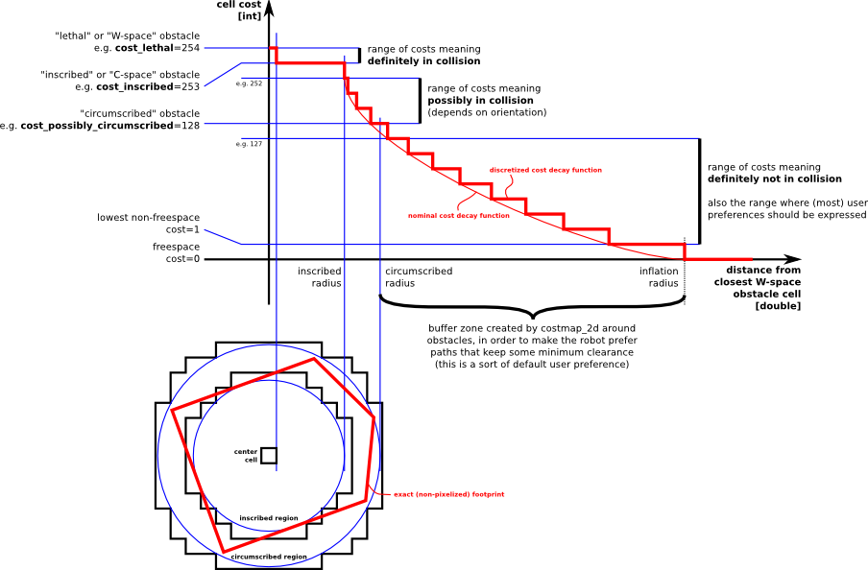
Navigation & AMCL
[costmap2d] concept
figure source: http://wiki.ros.org/costmap_2d
https://hypharosworkshop.wordpress.com/
Copyright © 2017 Hypha ROS Workshop. All rights reserved
Lecturer: HaoChih, LIN

Slide 12
Navigation & AMCL
[costmap2d] Layer Specifications
Static Map Layer
The static map layer represents a largely unchanging portion of the costmap, like those generated by SLAM.
Obstacle Map Layer
The obstacle layer tracks the obstacles as read by the sensor data. The ObstacleCostmapPlugin marks and raytraces obstacles in two dimensions, while the VoxelCostmapPlugin does so in three dimensions.
Inflation Layer
The inflation layer is an optimization that adds new values around lethal obstacles (i.e. inflates the obstacles) in order to make the costmap represent the configuration space of the robot.
Other Layers
Social Costmap Layer
Range Sensor Layer
figure source: http://wiki.ros.org/costmap_2d
https://hypharosworkshop.wordpress.com/
Copyright © 2017 Hypha ROS Workshop. All rights reserved
Lecturer: HaoChih, LIN

Slide 13
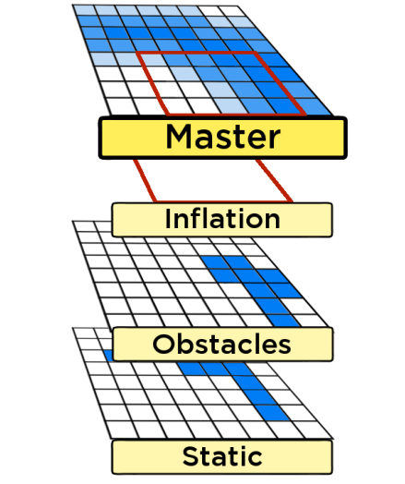
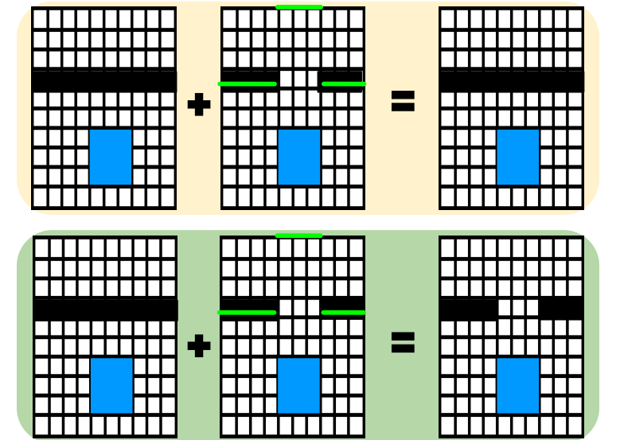
Navigation & AMCL
[costmap2d] Layer Specifications
figure source: http://roscon.ros.org/2014/wp-content/uploads/2014/07/ROSCON2014_DLu.pdf
https://hypharosworkshop.wordpress.com/
Copyright © 2017 Hypha ROS Workshop. All rights reserved
Lecturer: HaoChih, LIN

Slide 14
Navigation & AMCL
[costmap2d] Map Types (way to initialize a costmap_2d::Costmap2DROS object)
static map (for global costmap)
In this case, the costmap is initialized to match the width, height, and obstacle information provided by the static map. This configuration is normally used in conjunction with a localization system, like amcl, that allows the robot to register obstacles in the map frame and update its costmap from sensor data as it drives through its environment.
rolling_window (for local costmap)
The rolling_window parameter keeps the robot in the center of the costmap as it moves throughout the world, dropping obstacle information from the map as the robot moves too far from a given area. This type of configuration is most often used in an odometric coordinate frame where the robot only cares about obstacles within a local area.
https://hypharosworkshop.wordpress.com/
Copyright © 2017 Hypha ROS Workshop. All rights reserved
Lecturer: HaoChih, LIN

Slide 15
Navigation & AMCL
[costmap2d] Implementation (hypha-racecar/param/)
costmap_common_params.yaml
global_costmap_params.yaml
local_costmap_params.yaml
https://hypharosworkshop.wordpress.com/
Copyright © 2017 Hypha ROS Workshop. All rights reserved
Lecturer: HaoChih, LIN

Slide 16
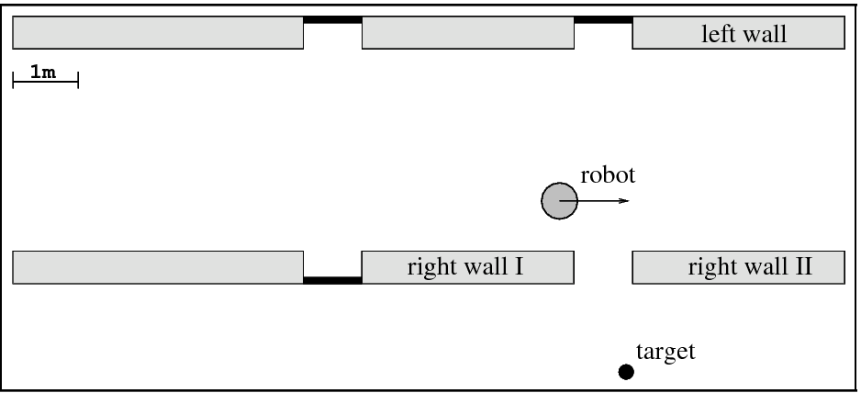
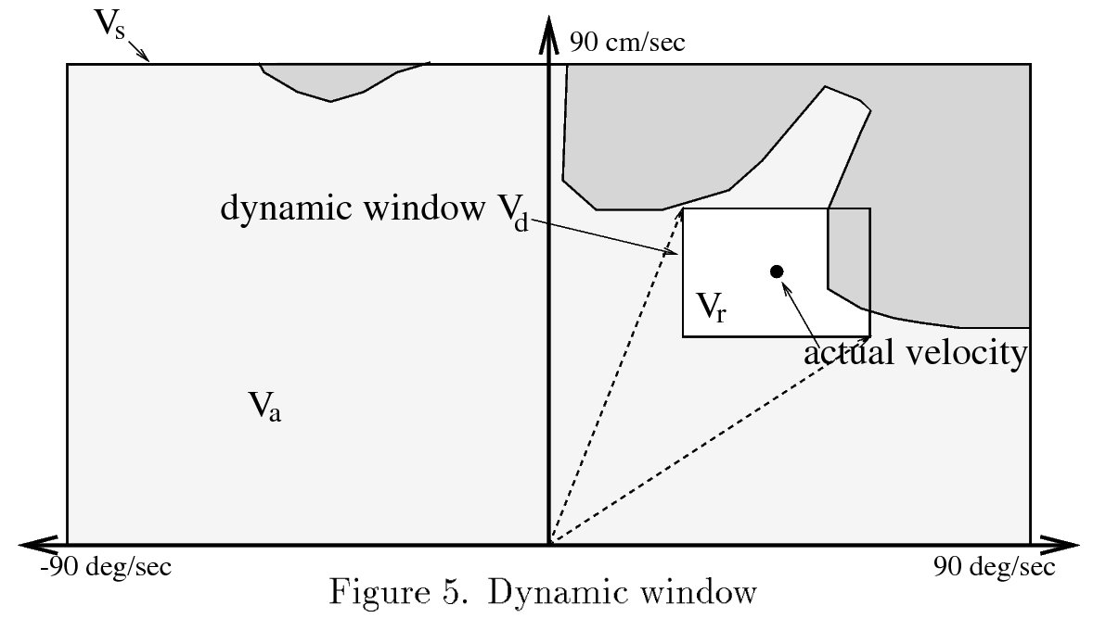
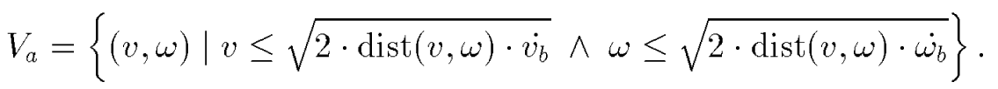
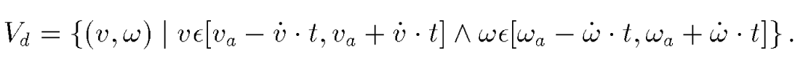
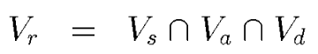
Navigation & AMCL
[DWA planner] concept
figure source: D. Fox, W. Burgard, and S. Thrun.
"The dynamic window approach to collision avoidance".
Vs is the space of possible velocities
Va is the set of velocity without colliding with an obstacle
Vd is dynamic window
Vr is defined as the intersection of the restricted area
https://hypharosworkshop.wordpress.com/
Copyright © 2017 Hypha ROS Workshop. All rights reserved
Lecturer: HaoChih, LIN

Slide 17
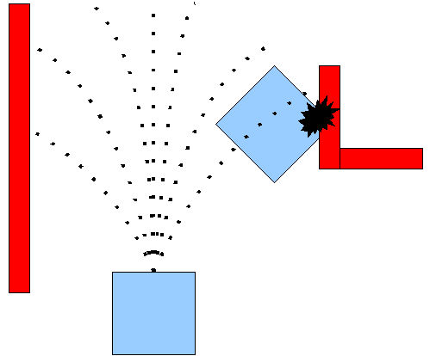
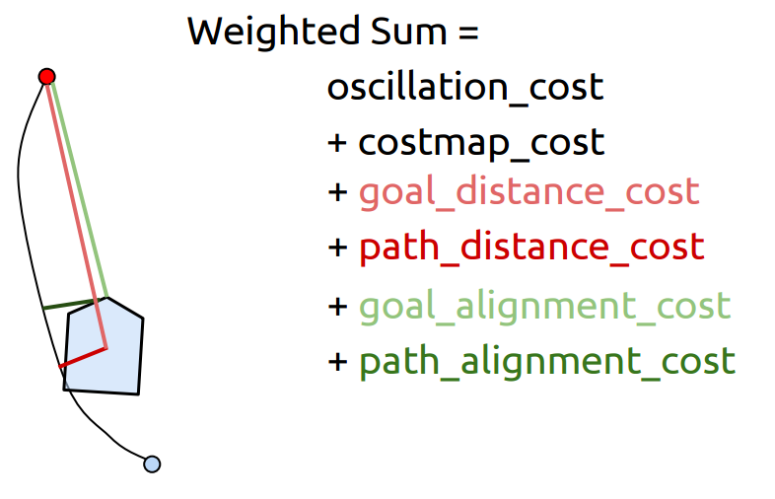
Navigation & AMCL
[DWA planner] concept
figure source: http://roscon.ros.org/2014/wp-content/uploads/2014/07/ROSCON2014_DLu.pdf
https://hypharosworkshop.wordpress.com/
Copyright © 2017 Hypha ROS Workshop. All rights reserved
Lecturer: HaoChih, LIN

Slide 18
Navigation & AMCL
[DWA planner] common params
See website: http://wiki.ros.org/dwa_local_planner
[DWA planner] Implementation
example: dwa_local_planner_params.yaml
robot
local costmap
global costmap
map
Red: global path
Blue: local path
Green: dwa
https://hypharosworkshop.wordpress.com/
Copyright © 2017 Hypha ROS Workshop. All rights reserved
Lecturer: HaoChih, LIN

Slide 19
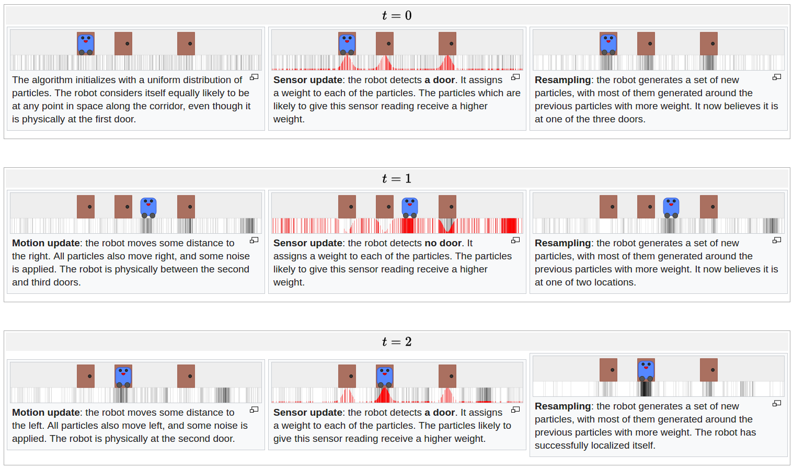
Navigation & AMCL
[AMCL] concept
figure source:
https://en.wikipedia.org/wiki/Monte_Carlo_localization
https://hypharosworkshop.wordpress.com/
Copyright © 2017 Hypha ROS Workshop. All rights reserved
Lecturer: HaoChih, LIN

Slide 20
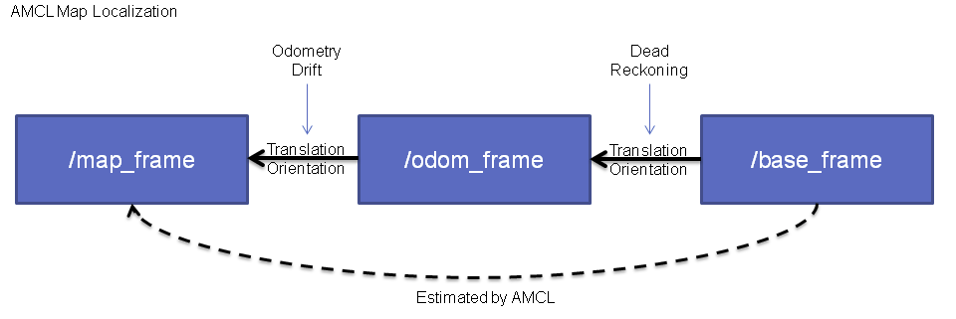
Navigation & AMCL
[AMCL] concept
Reference book: Probabilistic Robotics, by Thrun, Burgard, and Fox.
Reference Paper: https://papers.nips.cc/paper/1998-kld-sampling-adaptive-particle-filters.pdf
figure source: http://wiki.ros.org/amcl
https://hypharosworkshop.wordpress.com/
Copyright © 2017 Hypha ROS Workshop. All rights reserved
Lecturer: HaoChih, LIN

Slide 21
Navigation & AMCL
[AMCL] concept
Reference book: Probabilistic Robotics, by Thrun, Burgard, and Fox.
Reference Paper: https://papers.nips.cc/paper/1998-kld-sampling-adaptive-particle-filters.pdf
figure source: http://wiki.ros.org/amcl
https://hypharosworkshop.wordpress.com/
Copyright © 2017 Hypha ROS Workshop. All rights reserved
Lecturer: HaoChih, LIN

